Slide 1

Wild-Ireland
Educational Wildlife application that teaches through a first-person game.
By Jake Bolger

Slide 2



Background
Interactive experience
3D Game
Teaching students

Slide 3





Project Idea
1. Create an educational tool.
2. Learn about wildlife in Ireland.
3. Through a 3D first person game.
4. Explore and examine wildlife.
5. Access to information and ability to test the knowledge.

Slide 4
Requirements

Slide 5
Research

Slide 6
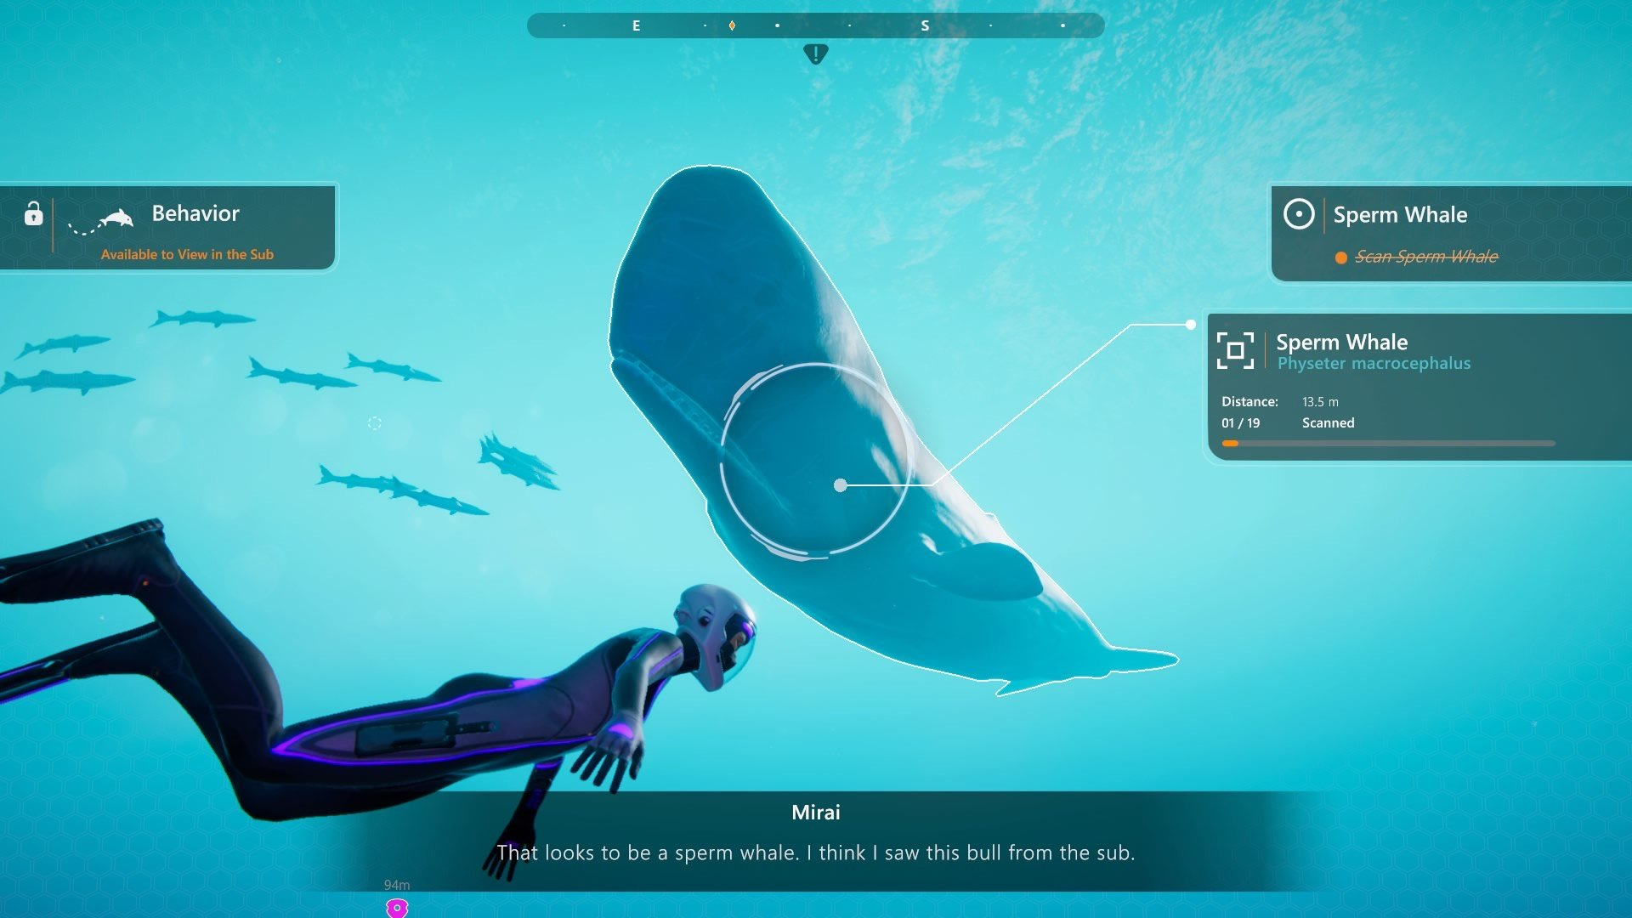
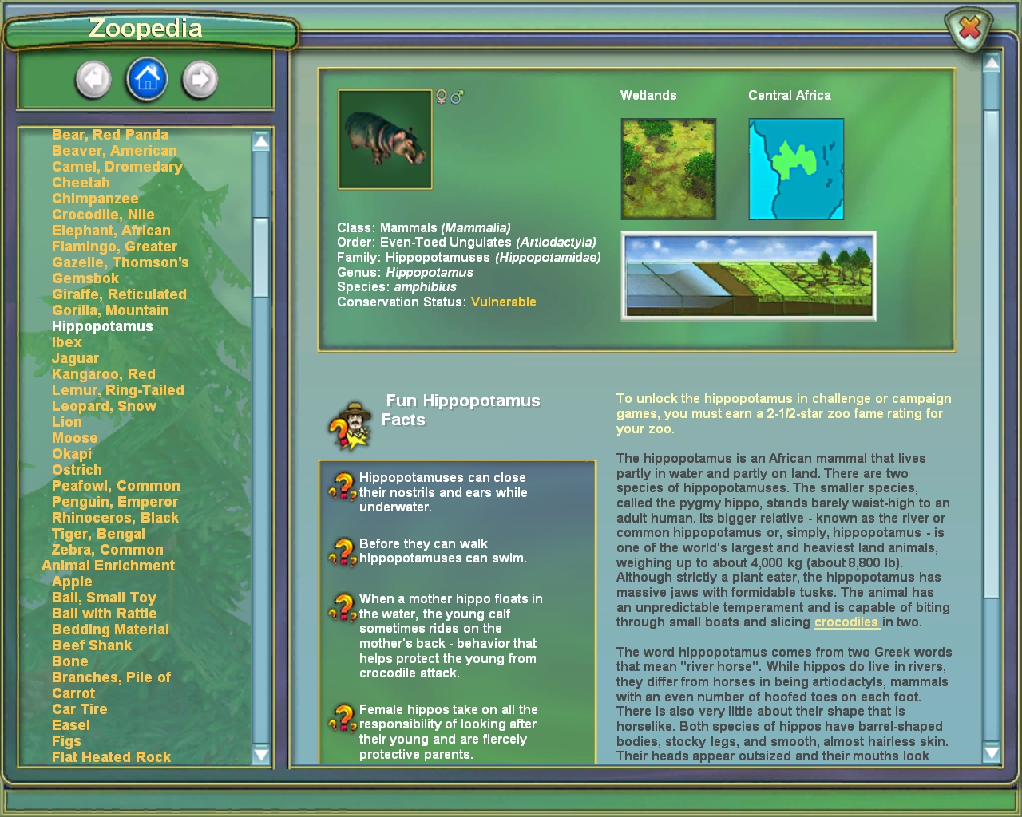
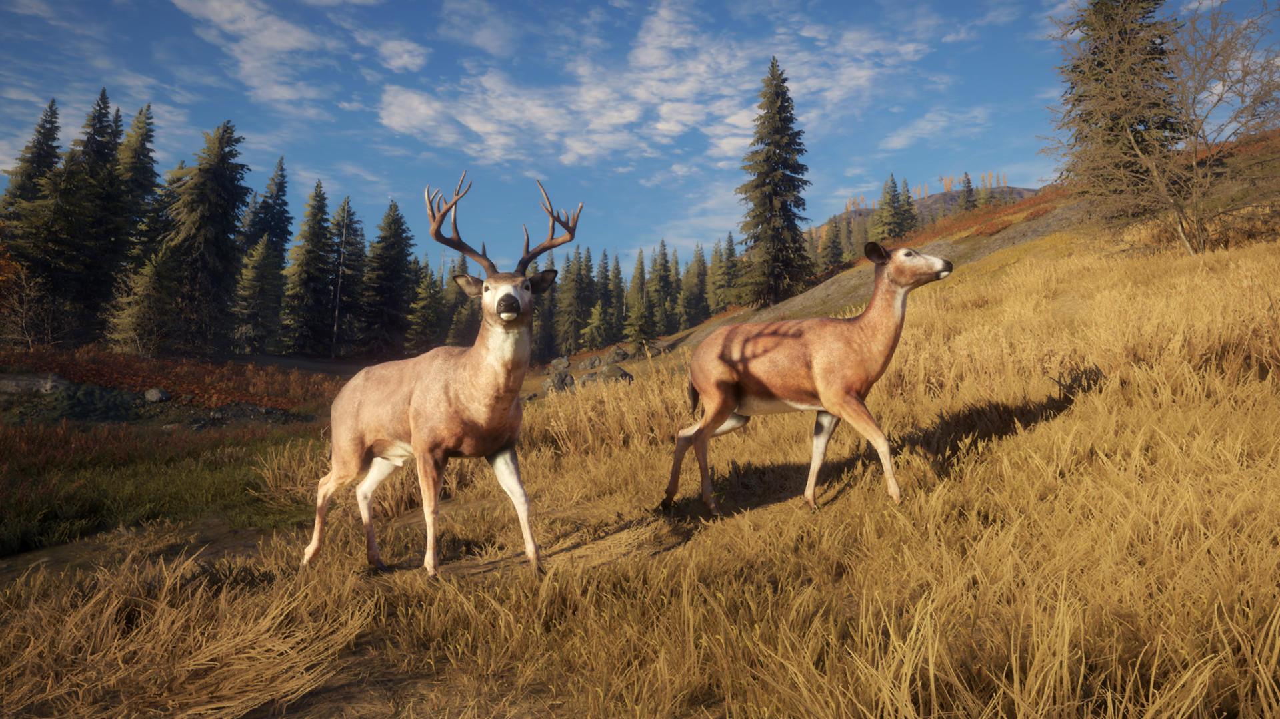
Existing Applications
1. Beyond Blue
3. Zoo Tycoon
2. The Hunter: Call of the Wild

Slide 7
Technologies
Game Engines
3D Modelling
Programming Language
Render Pipeline
Script Editors

Slide 8
Other Research
Cutscene
Inventory system
Inspection system
Save System
Procedural generation
AI research
Animation techniques
Audio
Assets
Final Year Projects

Slide 9
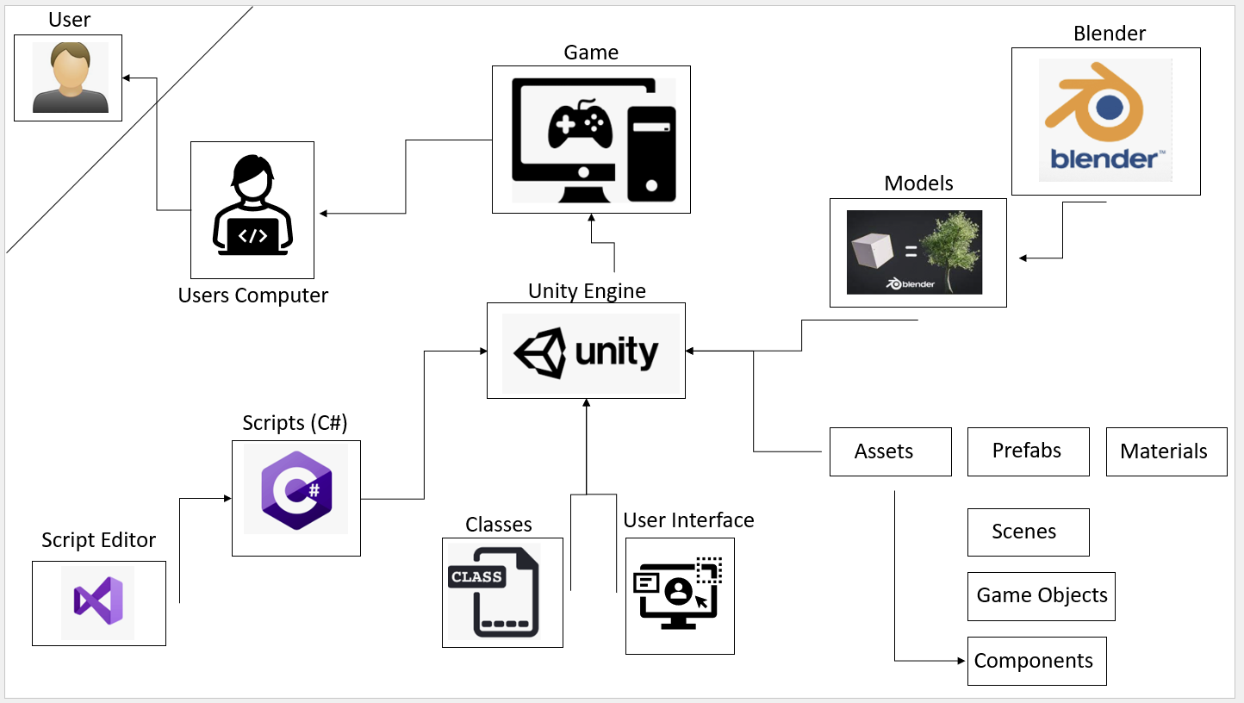
Design

Slide 10
Educational approach
ADDIE model.
Information.
Videos
Info
Pictures
Quizzes.
Academic Papers

Slide 11
Front end

Slide 12
Use Cases

Slide 13
System Design
Inspect system
Inventory system
Save system
Procedural animation
Map / Level Design
Animal AI
Art
Models
Audio

Slide 14
Complexity
Inventory, Inspection and Save system.
Procedural Generation.
Environment
Procedural Animation
Custom Models.
Blender
AI.
Pathfinding

Slide 15
Testing
White and Black Box Testing
Testing in Unity
Testing the AI
Test Plan Table

Slide 16
Issues and Future Work
Issues and Risks
Plans for Future Work
Gant Table

Slide 17
Application Demo

Slide 18

Questions?

